Slide 1
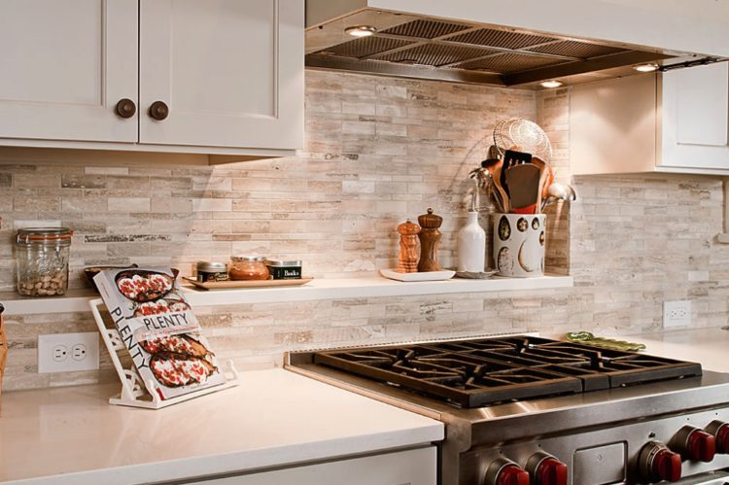
Recipes etc…
By “the Mama and the Pappas;”

Slide 2
The Mamma and the Poppas
Laureni Wilkinson – mother to a beauful 9 month old boy
Dellinger Rodrigues - father of a wonderful 3 year old boy and a 2 year old girl.
Chu Lin – father to a rambunctious almost 3 year old boy

Slide 3
Sales pitch here it comes

Slide 4

Are you guys ready? Can we get some thumbs up?

Slide 5
Get hyped!! Let’s we go!

Slide 6

Why would you use Recipes etc…?
Long day at work
So much work
It never stops

Slide 7
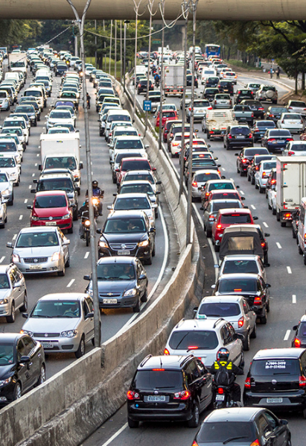
Why would you use Recipes etc…?
So much traffic
Where did these people come from?

Slide 8

Why would you use Recipes etc…?
You’re not home yet!
Don’t forget to pick up little Timmy from robot class
Don’t forget to pick up Diane from dance class

Slide 9

Recipes etc… to the rescue
At this point the last thing anyone wants to do is think about what to cook. Even if you don’t have any kids or work, is Recipe etc… for you? Of course it is, Recipes etc… is for anyone who is crazy about eating food from quality recipes. You only have 30 minutes? 45 minutes? You only have a single pot to cook with? Let Recips etc… do the thinking for you. Let Recipes etc… be your parachute

Slide 10
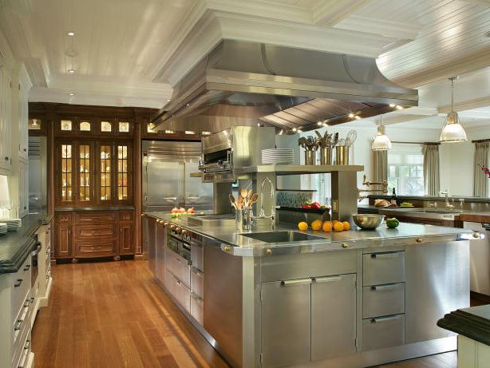



Here’s what you do
.

Slide 11
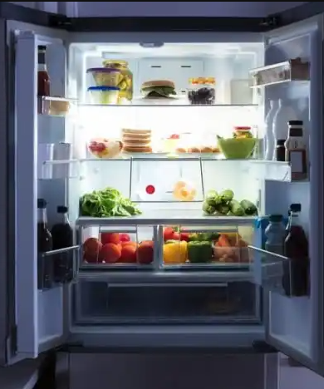
Take a look in your fridge and pantry,
Visit our interactive page at https://las348.github.io/Glova/
Search for recipes by ingredients
Search for recipes by time restraints
Recipes etc… will return 3 mouth watering recipes…

Slide 12

I know what you’re thinking..
While little Bobby, Annie, and that spouse are sitting in the next room, you’re cooking all by yourself.
Rest assured, After you have found your wonderful recipes from Recipes etc… You click on the affiliated youtube video below. Cozy up with your favorite wine, and knife, cook your troubles away.
Recipes etc… will NOT let you cook alone.
Recipes etc… We’ve got your back!

Slide 13
End sales pitch

Slide 14
Project requirements used:
Motivation: An application to help the busy person to easy and quick recipes.
APIs used: Edamam and Youtube
AJAX is used to call all
Technologies used: Bootstrap, W3Schools frameworks Explain how each tech was used**

Slide 15
Recipes etc…

Slide 16
Recipes etc…
Identify features on the page Point out where to go to do what

Slide 17
Recipes etc…
ADD BASIC features here
And talk about it

Slide 18

Laureni Wilkerson
Contributions
Youtube API and video embedding integration

Slide 19

Dellinger Rodriguez
Contributions
Edamam API and video embedding integration
HTML bootstrap integration

Slide 20

ChU Lin
Contributions
Powerpoint presentation

Slide 21
Questions & Answers?

